Slide 1

C Programming Project Presentation
Project Title: Simple Payroll Slip Generator
Course: C Programming Lab / Mini Project
Student Name & Roll No: NAKUL(25BCS131),NANDHINI(25BCS132),NAVEEN(25BCS133),NIRANJAN(25BCS134),NITHESH(25BCS135)
Department: computer science
Mentor / Guide: [ mrs : Ashwanandhini ]

Slide 2
Introduction
C Programming Project Presentation
This project demonstrates a C-based payroll slip generator.
It automates employee salary computation and slip generation.
The project highlights use of loops, functions, structures, and file handling in C.

Slide 3
Objective
C Programming Project Presentation
To design a C program for generating payroll slips automatically.
To calculate gross and net salary based on employee input.
To utilize file handling for record storage and retrieval.

Slide 4
Problem Statement
C Programming Project Presentation
Manual payroll preparation can lead to errors and inefficiency.
This system aims to automate payroll slip generation for accuracy and convenience.

Slide 5
System Requirements
C Programming Project Presentation
Hardware Requirements:
• Processor: Intel i3 or higher
• RAM: 4 GB minimum
• Storage: 500 MB free space
Software Requirements:
• OS: Windows / Linux
• Compiler: GCC / Turbo C / Code::Blocks / Dev C++

Slide 6
System Design
C Programming Project Presentation
System Flow: Input → Process → Output → File Save
Includes modules for data entry, computation, and storage.
Below is the flowchart representing the process:

Slide 7
Module Description
C Programming Project Presentation
Input Module – Accepts employee details (name, ID, basic pay).
Processing Module – Calculates HRA, DA, and deductions.
Output Module – Displays payroll slip with gross and net salary.
File Handling Module – Saves employee salary details in text file.

Slide 8
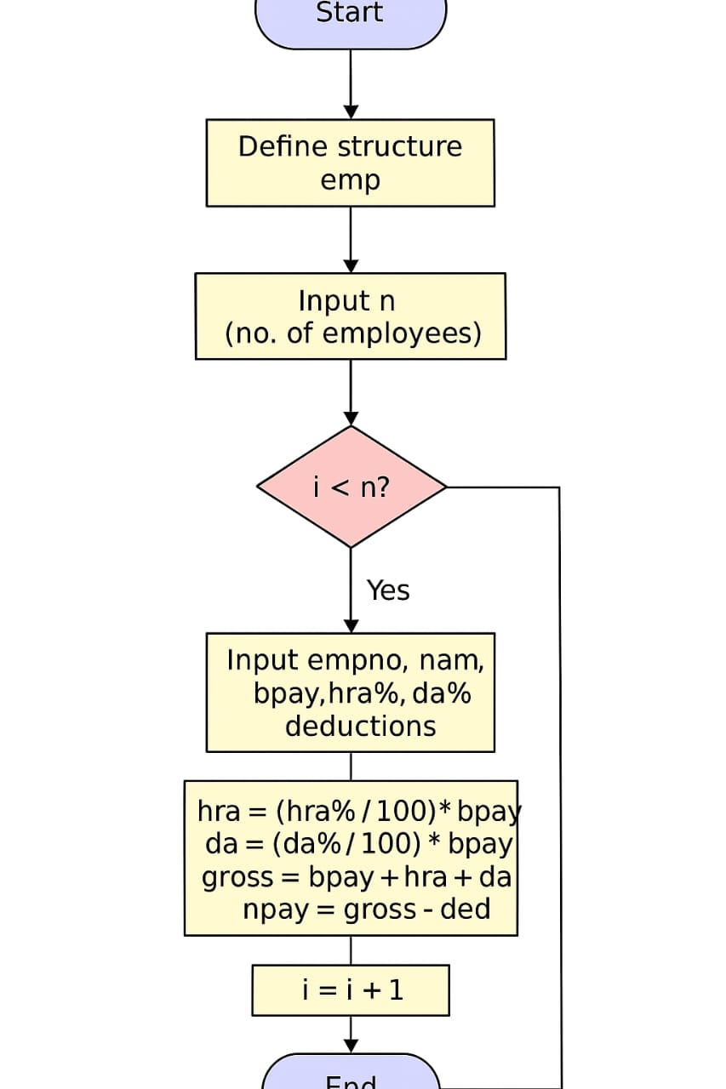
Algorithm / Flowchart
C Programming Project Presentation
1. Start
2. Input employee details
3. Compute allowances and deductions
4. Calculate gross and net salary
5. Display slip and save record
6. Stop

Slide 9
Implementation
C Programming Project Presentation
Key Features:
• Uses structures for employee records.
• Functions for salary computation and file operations.
Example:
struct Employee { char name[50]; int id; float basic, hra, da, ded, gross, net; };
void calc(struct Employee *e) { e->gross = e->basic + e->hra + e->da; e->net = e->gross - e->ded; }

Slide 10
Output Screens
C Programming Project Presentation
Displays formatted payroll slip on console.
Sample Output:
Employee Name: Priya | ID: 101
Gross Salary: 30000 | Net Salary: 28000
Data saved to payroll.txt

Slide 11
Results & Discussion
C Programming Project Presentation
• Summary of outputs
• Comparison with expected results
• Accuracy and performance observations
• Challenges faced and how they were resolved

Slide 12
Conclusion & Future Enhancement
C Programming Project Presentation
The project successfully automates payroll slip generation using C.
It improves efficiency and demonstrates file handling techniques.
Future Enhancements: GUI interface, Database integration, Multi-user support.

Slide 13
References / Acknowledgement
C Programming Project Presentation
References:
• Let Us C – Yashavant Kanetkar
• C Programming – E. Balagurusamy
• Online resources and documentation
Acknowledgement:
• Express gratitude to mentor, department, and team members

Slide 14
Thank You
Suggestions to improve the project are welcome.
Motto: “Automating Accuracy, Simplifying Payroll”

